Slide 1
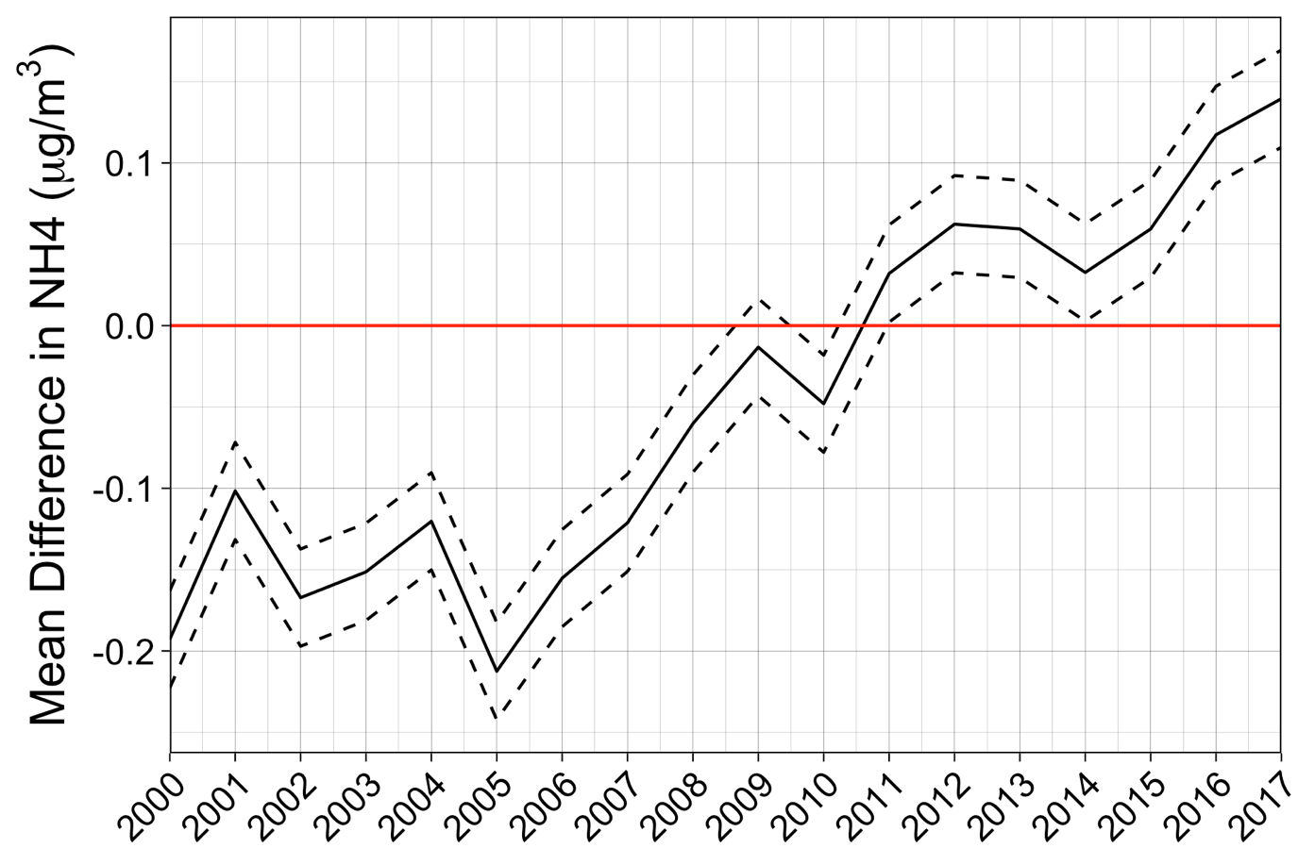
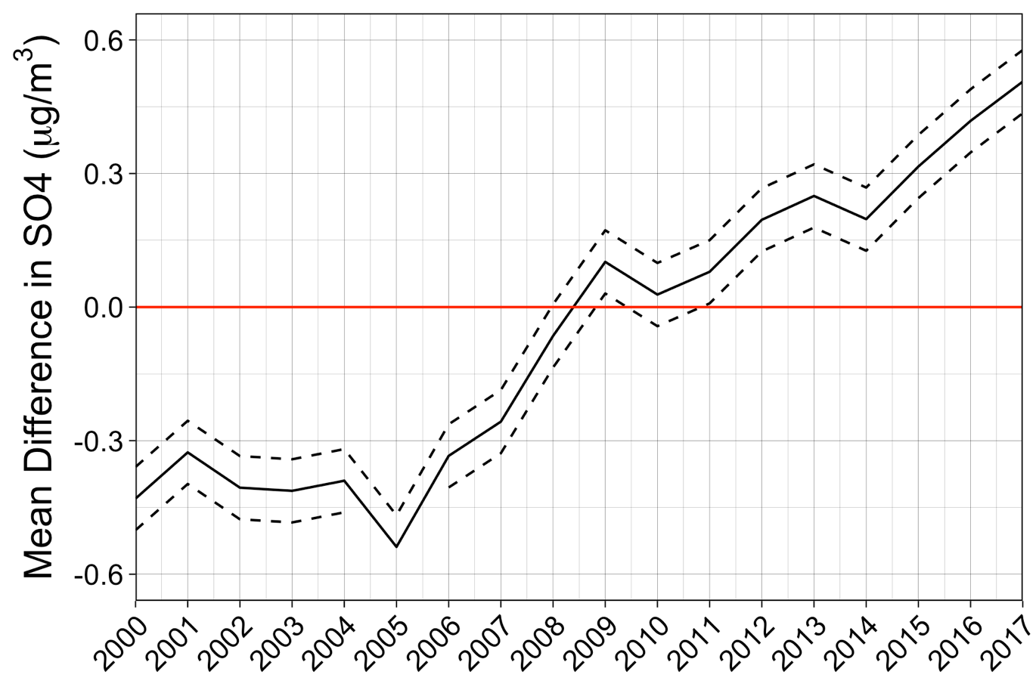
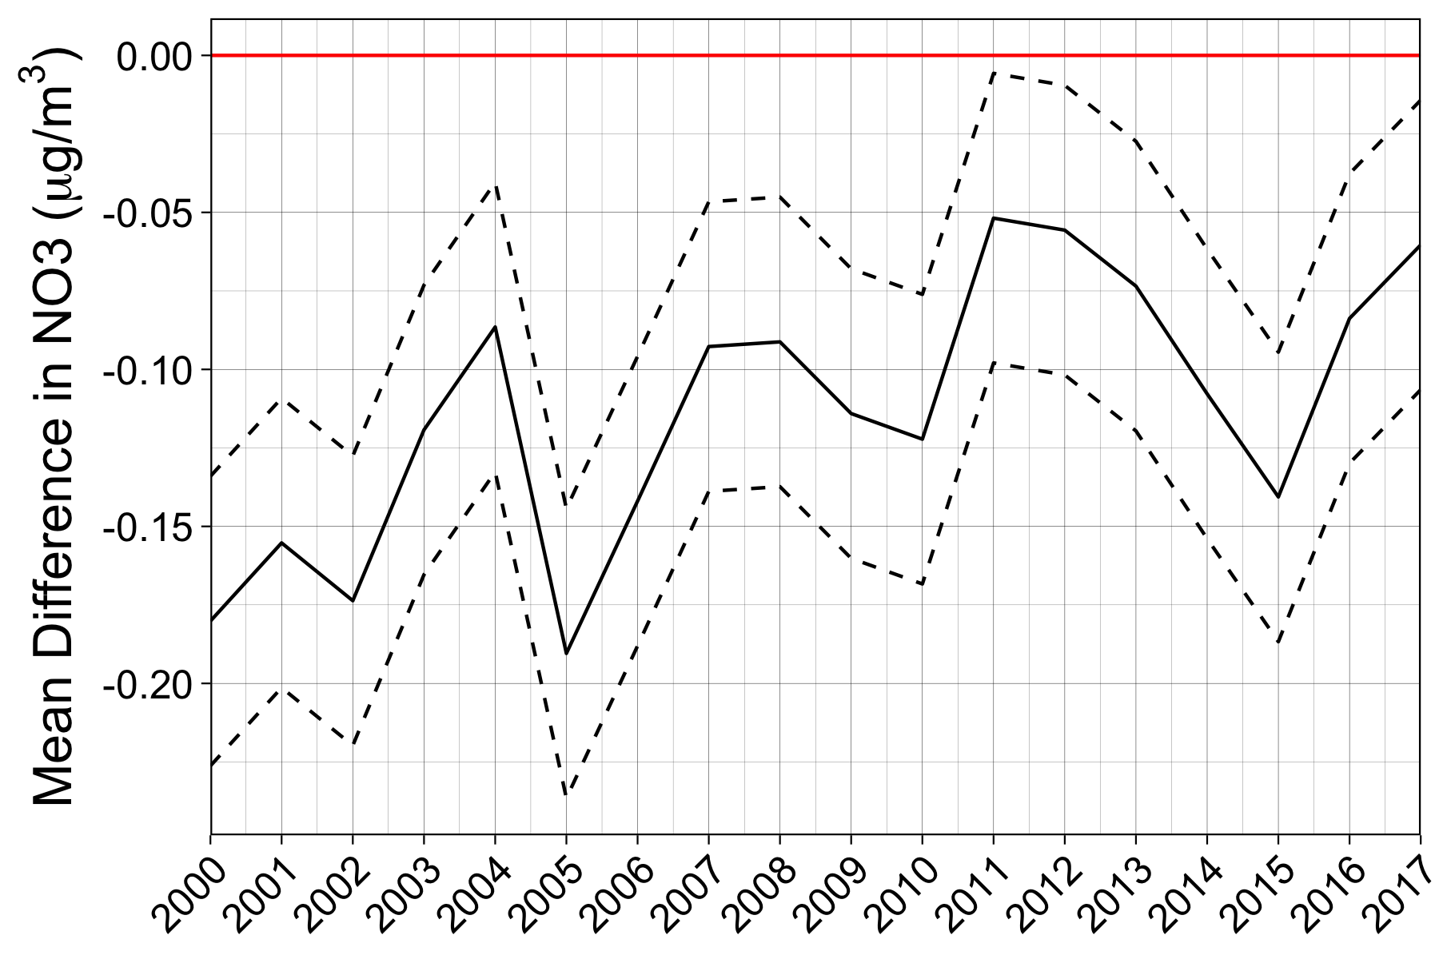
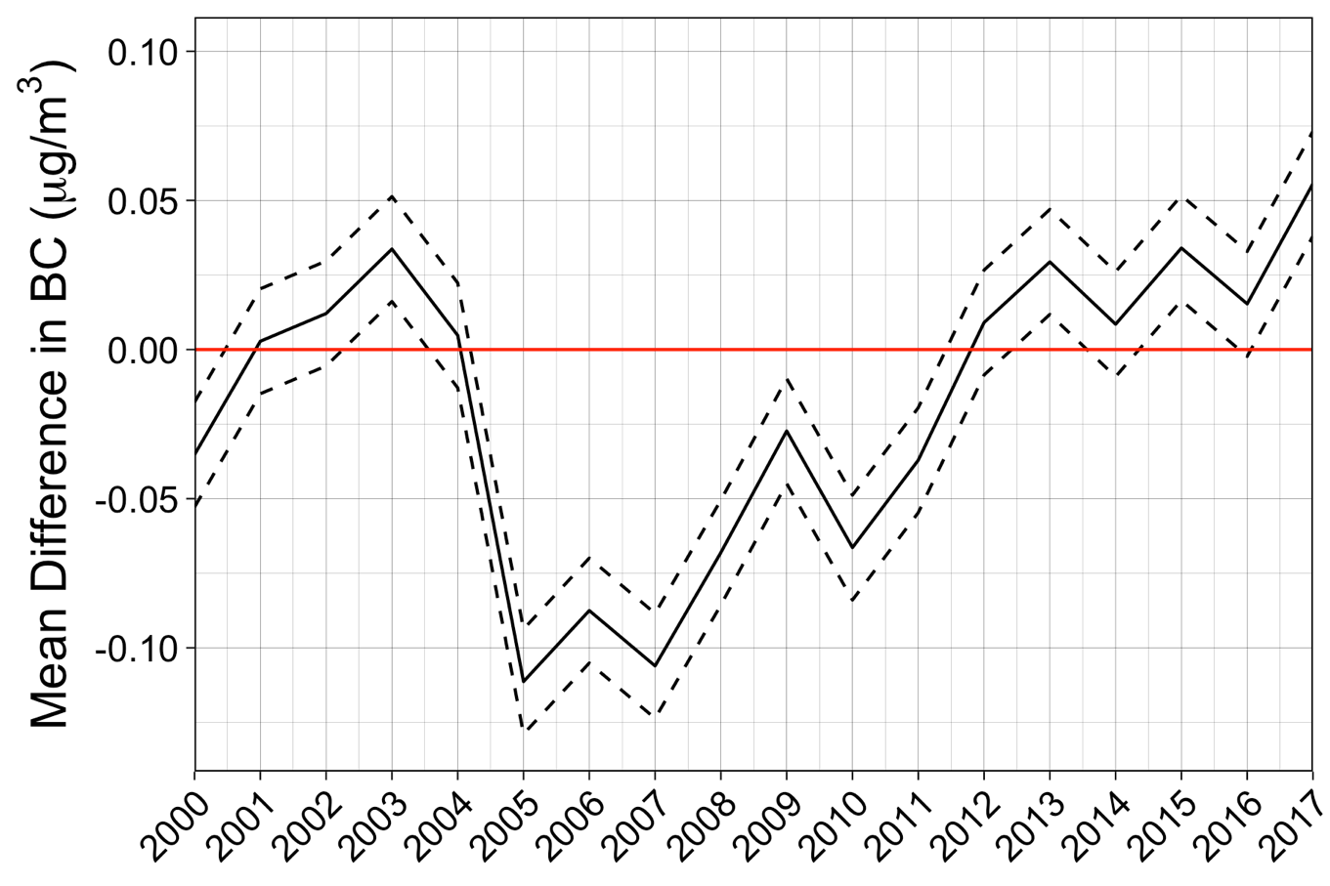
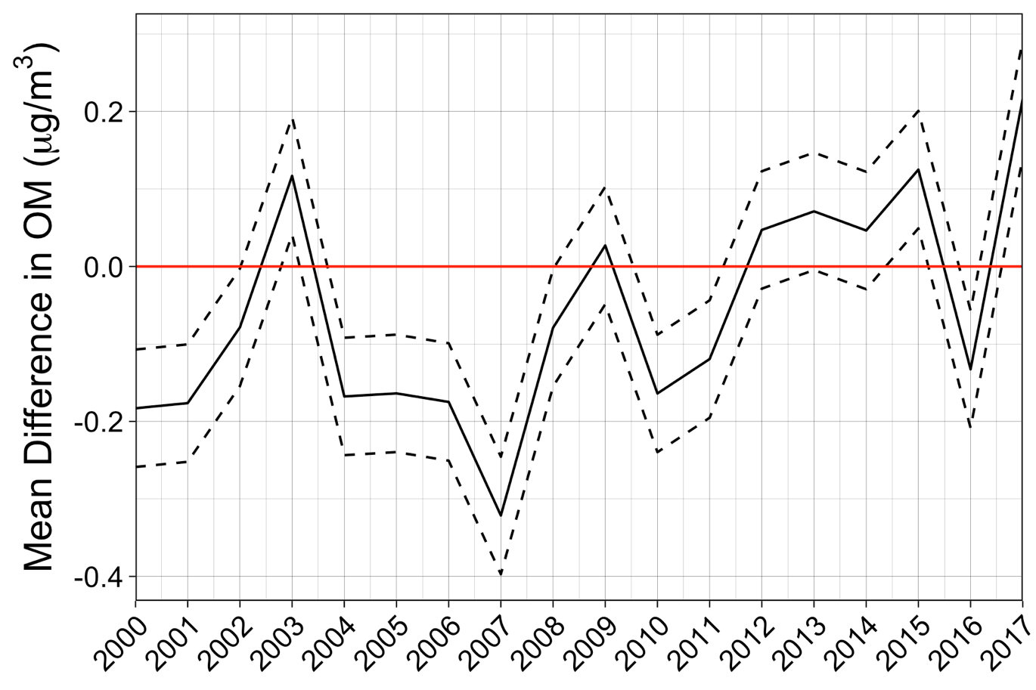
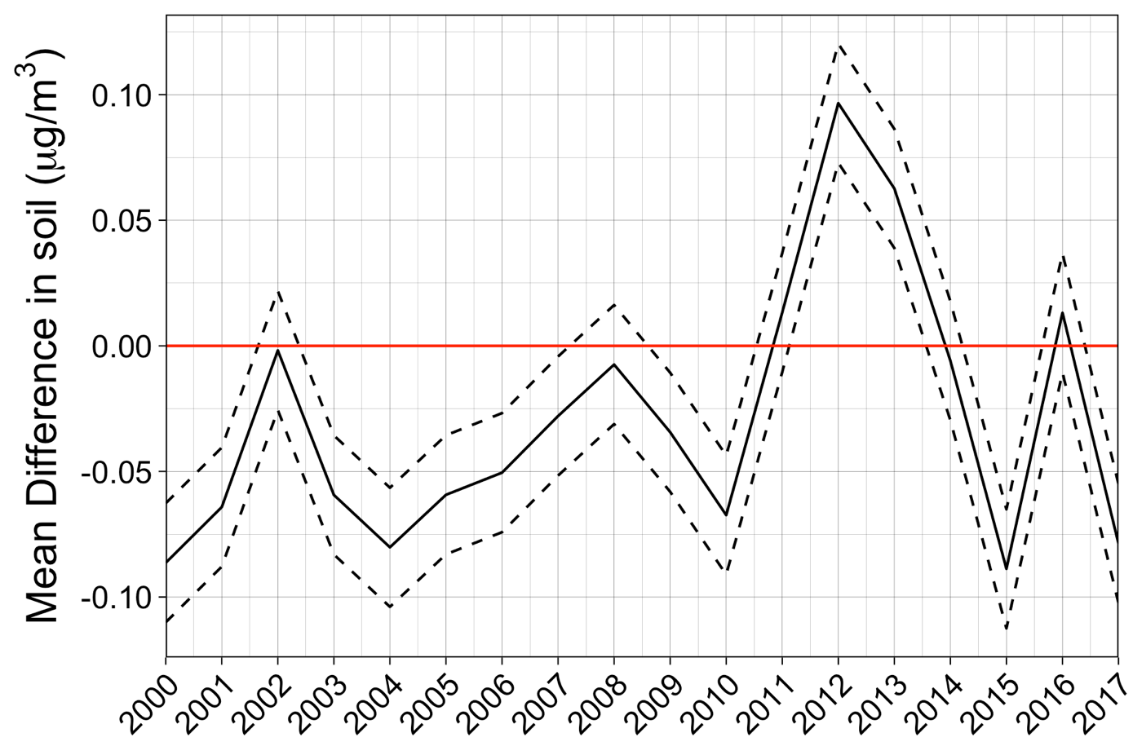
Mean difference in PM_{2.5} component trends by AI-populated county type †
Li et al., In preparation
NH₄
SO₄
NO₃
PM_{2.5} Component (μg/m³)
BC
OM
SOIL
† Adjusted for year, random intercepts for counties within states, population density, income, and county type × year interaction.
Notes:
Different Y axes

Slide 2
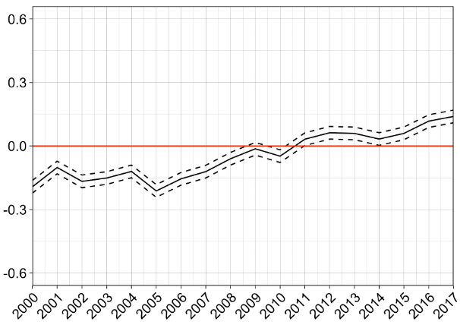
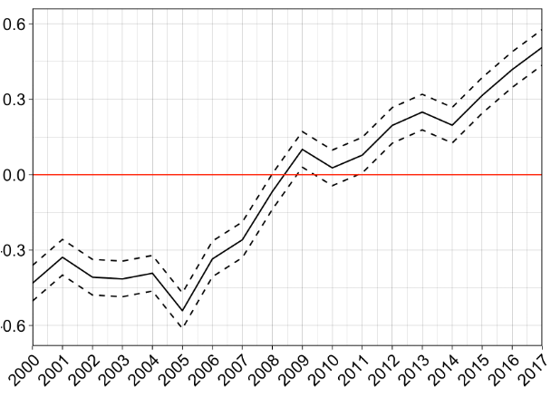
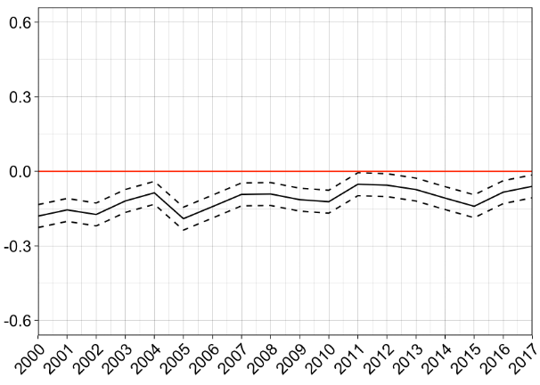
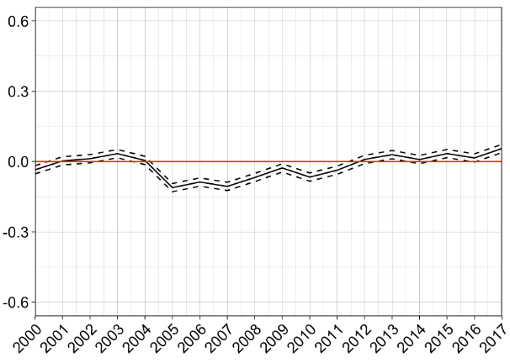
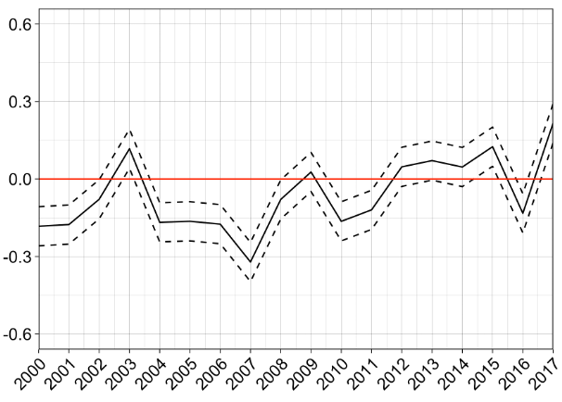
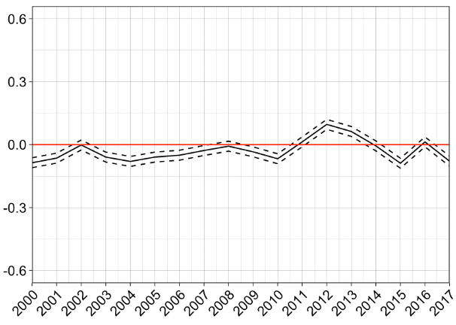
Mean difference in PM_{2.5} component trends by AI-populated county type †
Li et al., In preparation
NH₄
SO₄
NO₃
PM_{2.5} Component (μg/m³)
BC
OM
SOIL
† Adjusted for year, random intercepts for counties within states, population density, income, and county type × year interaction.
Notes:
Different Y axes

Slide 3
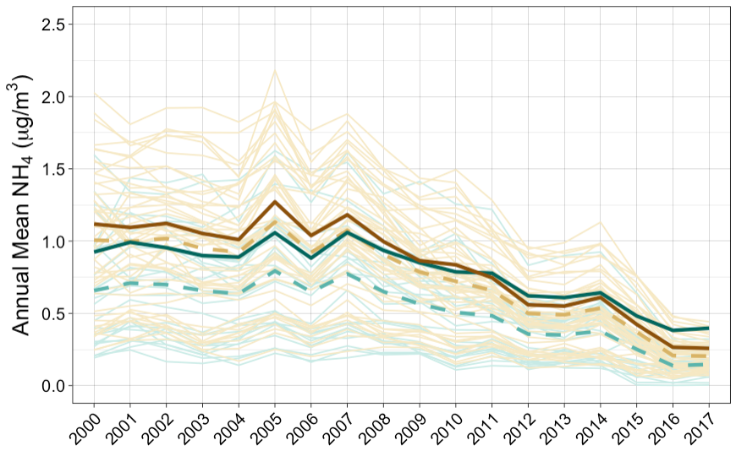
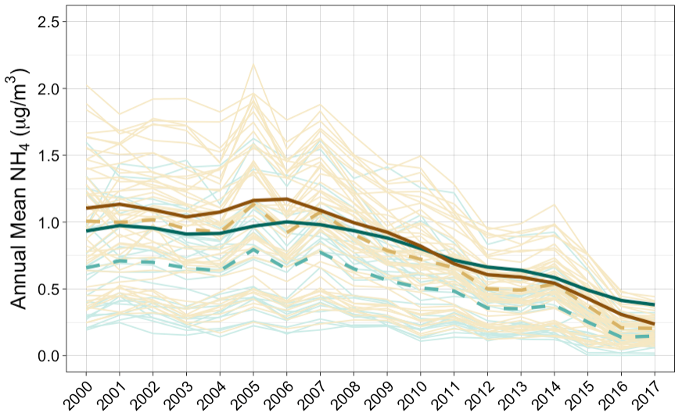
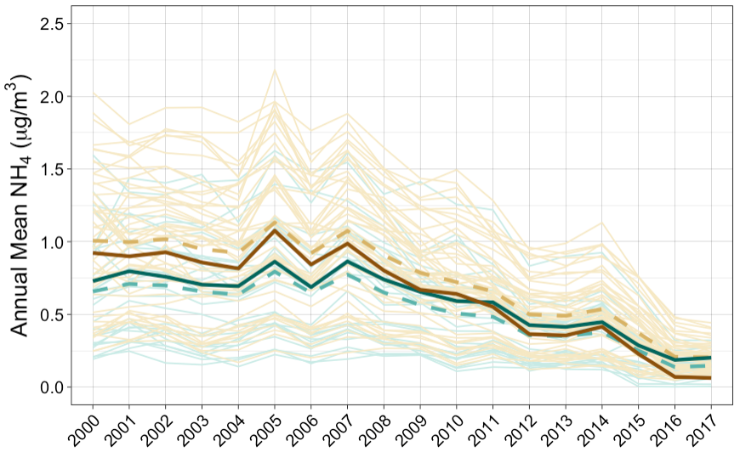
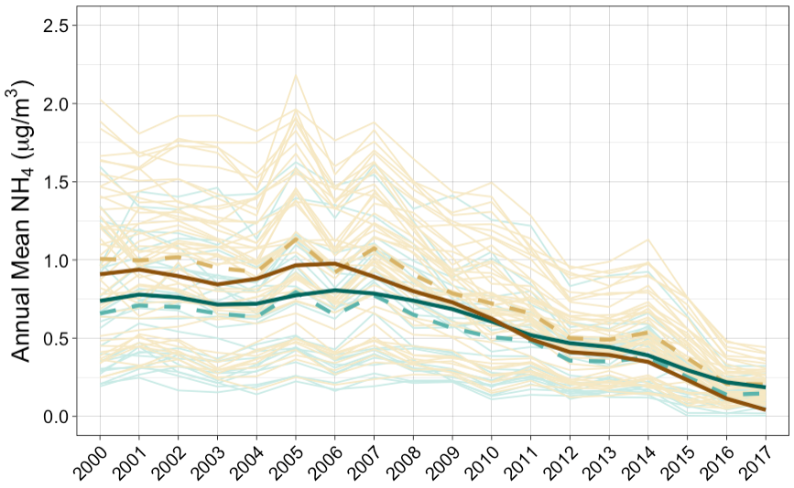
GAMM4 interX categorical year and county type
GAMM4 year as penalized spline s(year, by = county type, k=10)
* Annual predicted NH₄ in most common non-AI decile of HH income ($57.5k–116k) and pop density (160-382 persons/mi²)
Non-AI-populated counties
Observed annual means by state
Observed annual means (all states)
Estimated annual means*
AI-populated counties
Observed annual means by state
Observed annual means (all states)
Estimated annual means*
* Annual predicted NH₄ in most common AI decile of HH income ($35.6k–38k) and pop density (4.4-12.7 persons/mi²)

Slide 4
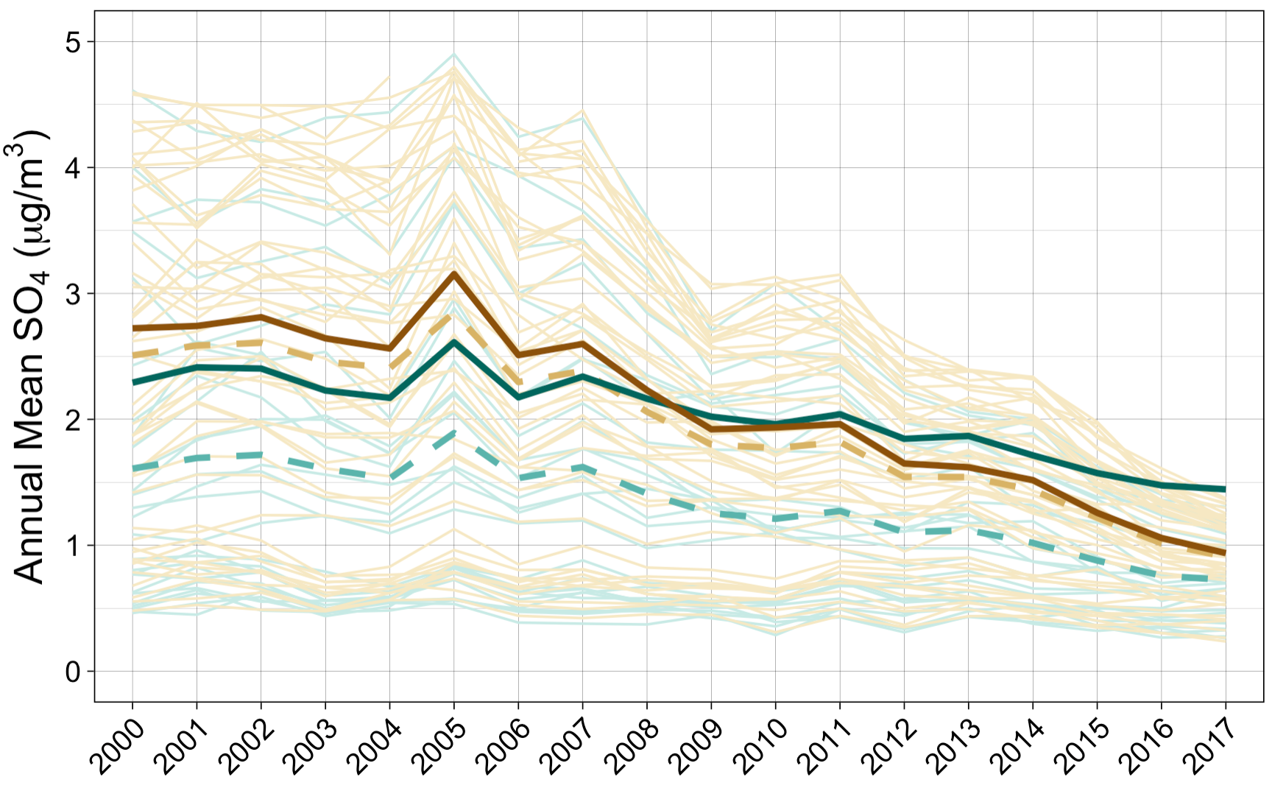
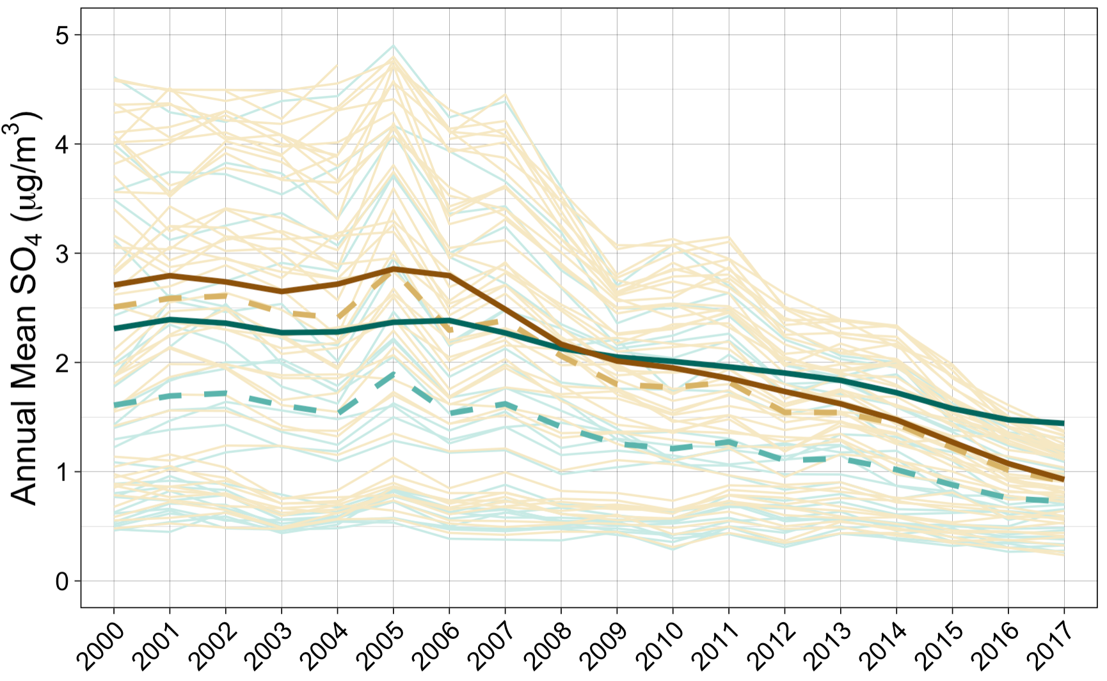
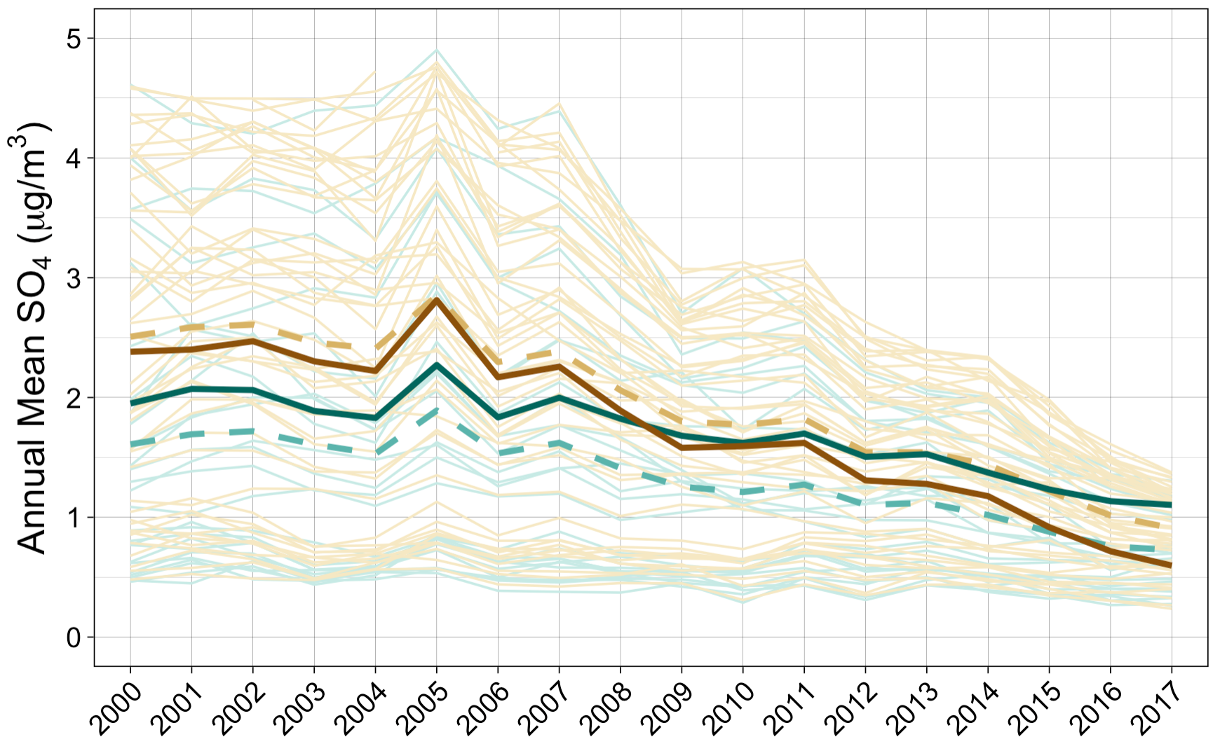

GAMM4 interX categorical year and county type
GAMM4 year as penalized spline s(year, by = county type, k=10)
* Annual predicted SO₄ in most common non-AI decile of HH income ($57.5k–116k) and pop density (160-382 persons/mi²)
Non-AI-populated counties
Observed annual means by state
Observed annual means (all states)
Estimated annual means*
AI-populated counties
Observed annual means by state
Observed annual means (all states)
Estimated annual means*
* Annual predicted SO₄ in most common AI decile of HH income ($35.6k–38k) and pop density (4.4-12.7 persons/mi²)

Slide 5
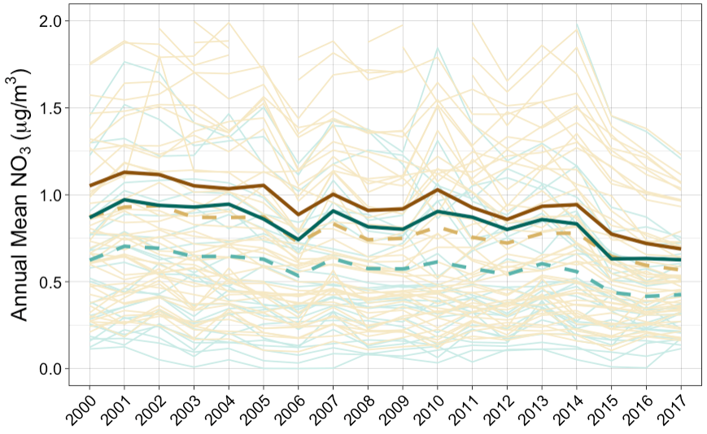
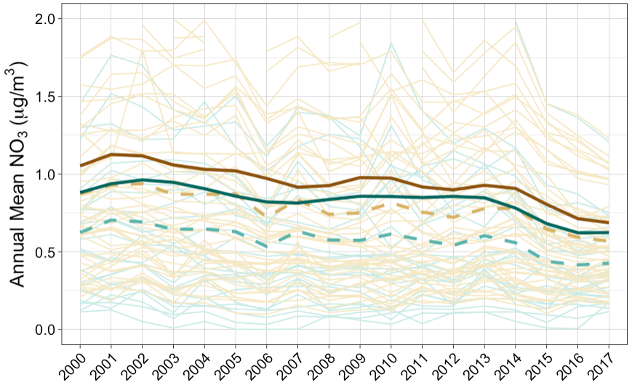
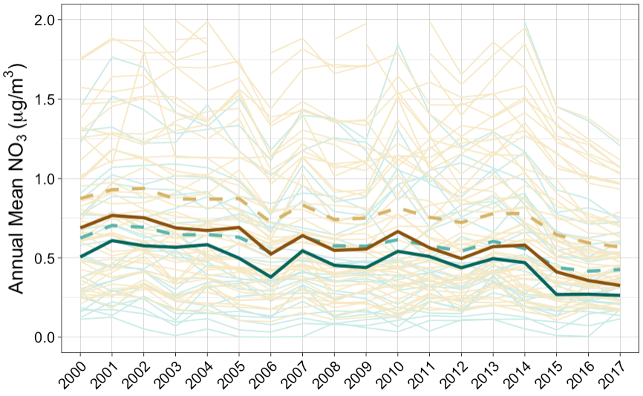
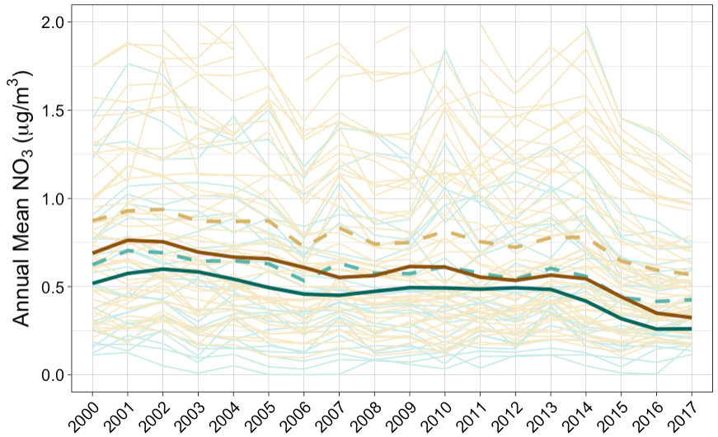
GAMM4 interX categorical year and county type
GAMM4 year as penalized spline s(year, by = county type, k=10)
*Annual predicted NO₃ in most common non-AI decile of HH income ($57.5k–116k) and pop density (160-382 persons/mi²)
Non-AI-populated counties
Observed annual means by state
Observed annual means (all states)
Estimated annual means*
AI-populated counties
Observed annual means by state
Observed annual means (all states)
Estimated annual means*
* Annual predicted NO₃ in most common AI decile of HH income ($35.6k–38k) and pop density (4.4-12.7 persons/mi²)

Slide 6
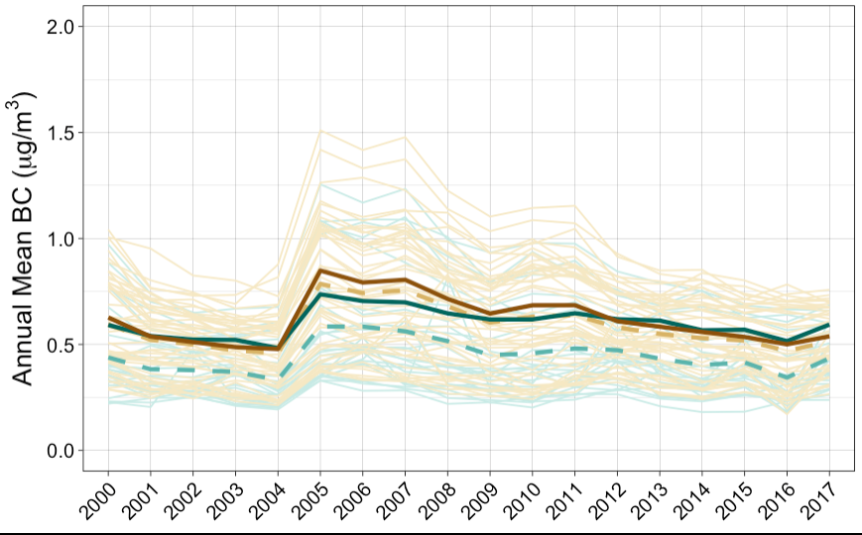

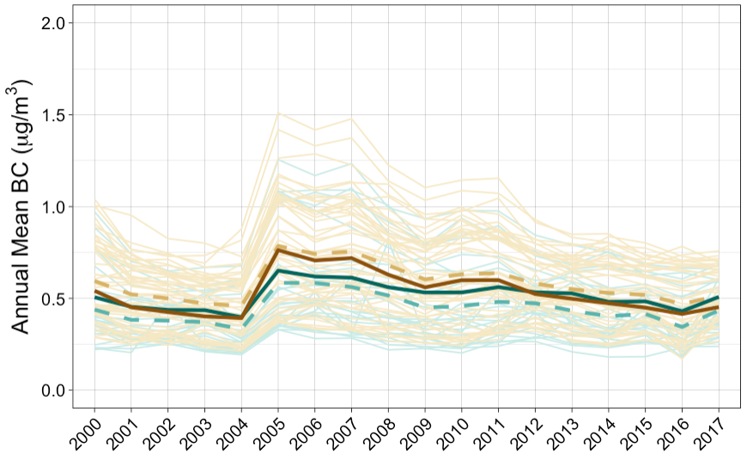

GAMM4 interX categorical year and county type
GAMM4 year as penalized spline s(year, by = county type, k=10)
*Annual predicted BC in most common non-AI decile of HH income ($57.5k–116k) and pop density (160-382 persons/mi²)
Non-AI-populated counties
Observed annual means by state
Observed annual means (all states)
Estimated annual means*
AI-populated counties
Observed annual means by state
Observed annual means (all states)
Estimated annual means*
*Annual predicted BC in most common AI decile of HH income ($35.6k–38k) and pop density (4.4-12.7 persons/mi²)

Slide 7
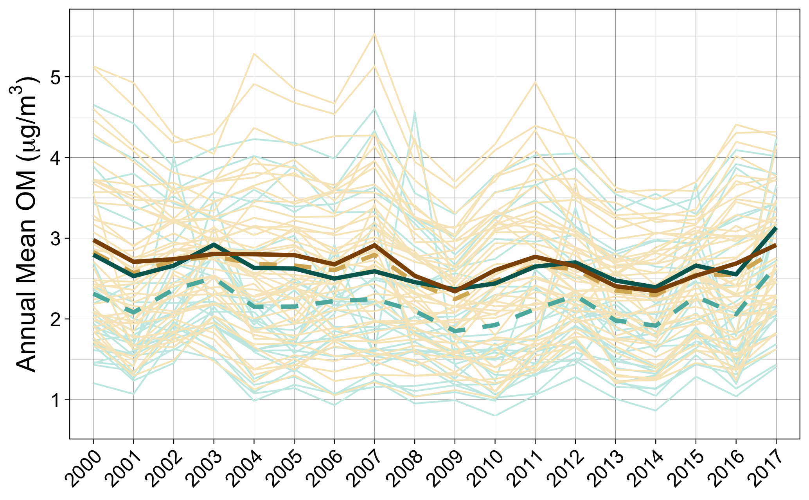
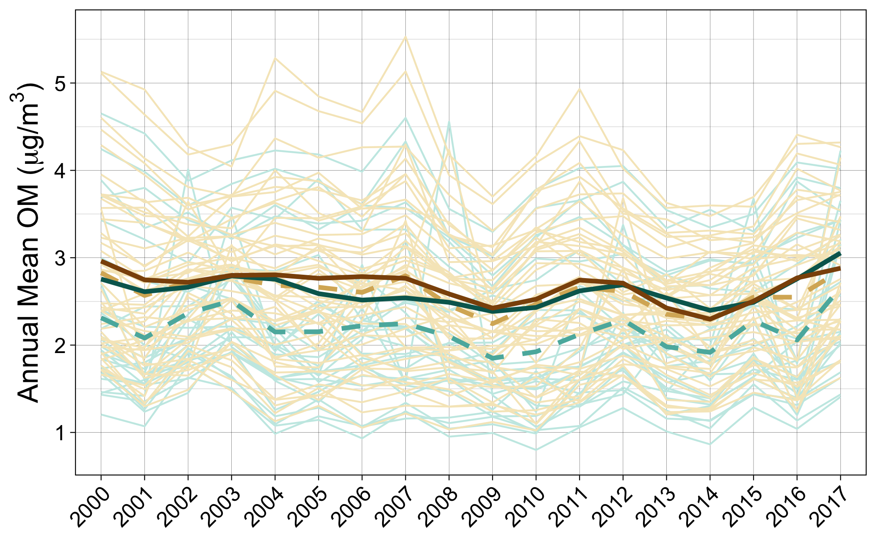
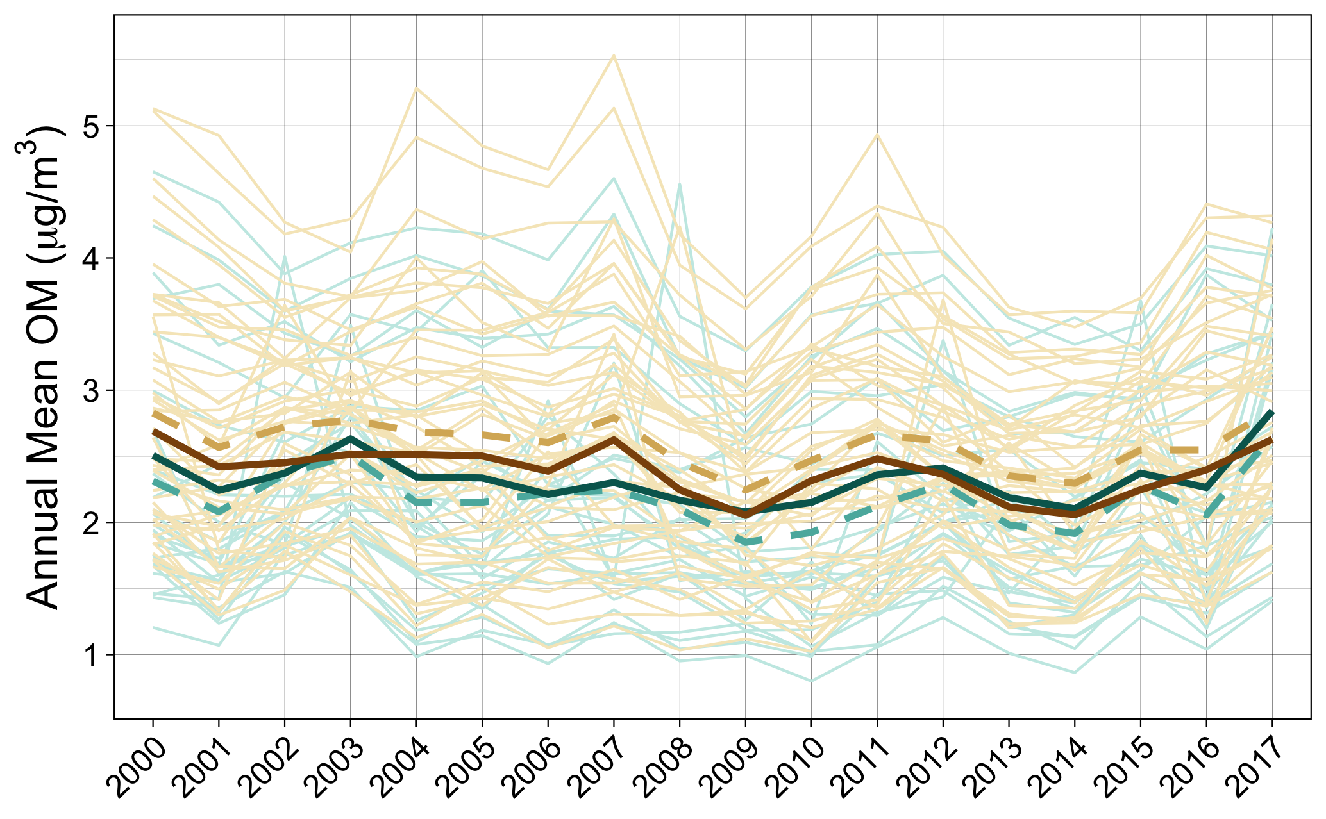
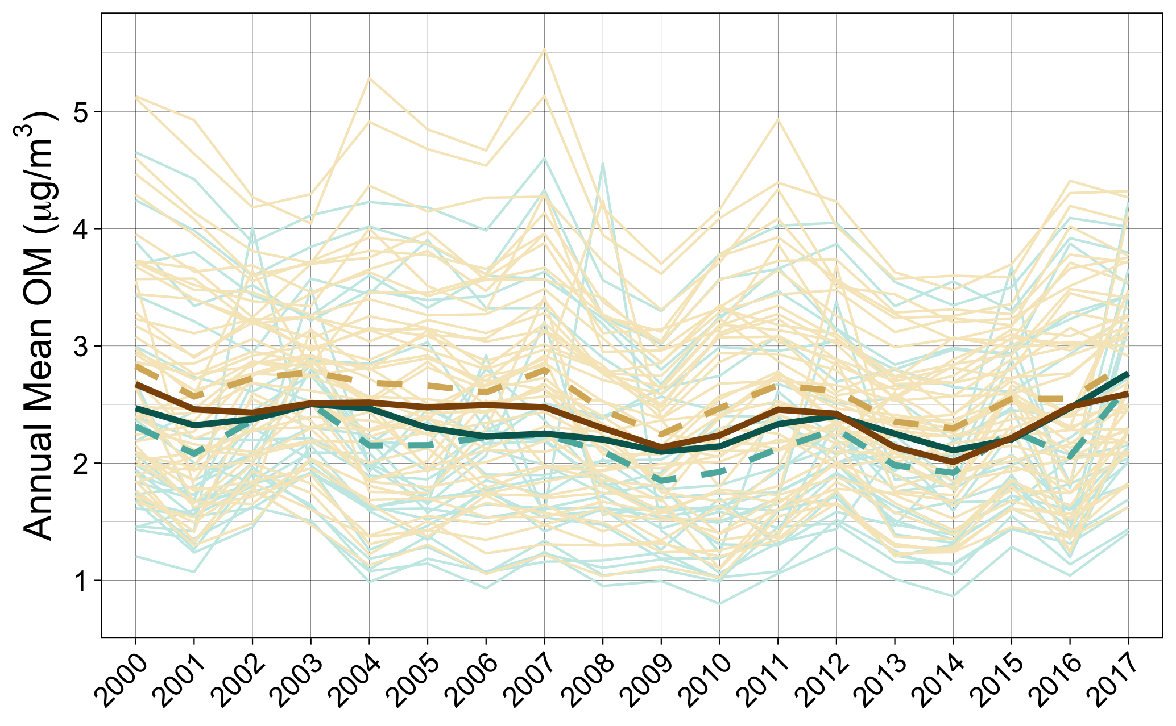
GAMM4 interX categorical year and county type
GAMM4 year as penalized spline s(year, by = county type, k=10)
* Annual predicted OM in most common non-AI decile of HH income ($57.5k–116k) and pop density (160-382 persons/mi²)
Non-AI-populated counties
Observed annual means by state
Observed annual means (all states)
Estimated annual means*
AI-populated counties
Observed annual means by state
Observed annual means (all states)
Estimated annual means*
* Annual predicted OM in most common AI decile of HH income ($35.6k–38k) and pop density (4.4-12.7 persons/mi²)

Slide 8
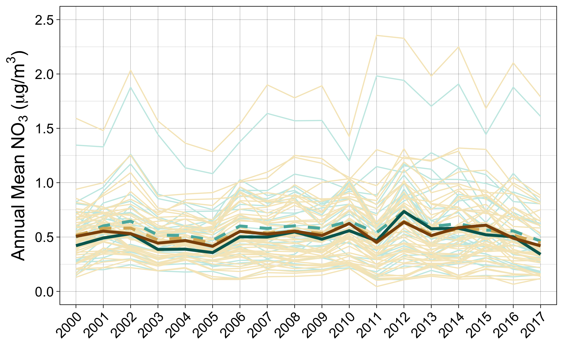
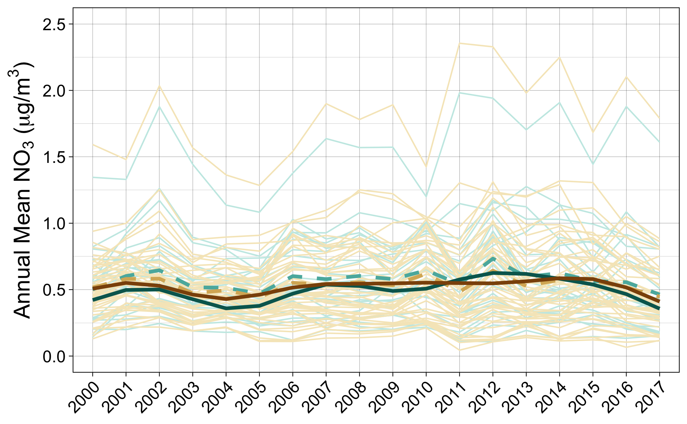

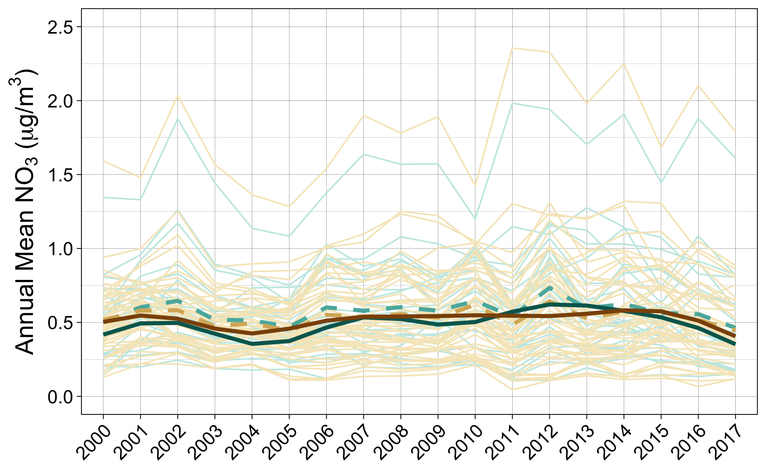
GAMM4 interX categorical year and county type
GAMM4 year as penalized spline s(year, by = county type, k=10)
* Annual predicted SOIL in most common non-AI decile of HH income ($57.5k–116k) and pop density (160-382 persons/mi²)
Non-AI-populated counties
Observed annual means by state
Observed annual means (all states)
Estimated annual means*
AI-populated counties
Observed annual means by state
Observed annual means (all states)
Estimated annual means*
* Annual predicted SOIL in most common AI decile of HH income ($35.6k–38k) and pop density (4.4-12.7 persons/mi²)

